Slide 1
Transform your vision into reality!
Project deck · 2026
hey@theananta.in

Slide 2
About us
We're a tight-knit team of experts creating memorable, emotion-driven websites, digital experiences and native apps. Since 2020 we've strived to build the best products and execute every project to the highest standard.
We're constantly in pursuit of new trends and technologies, so we can meet our customers' needs in the best possible way. Our top priority is to design and deliver projects within the agreed timeframe, at the highest quality.
6+
Years of experience
48+
Projects
10+
Awards

Slide 3



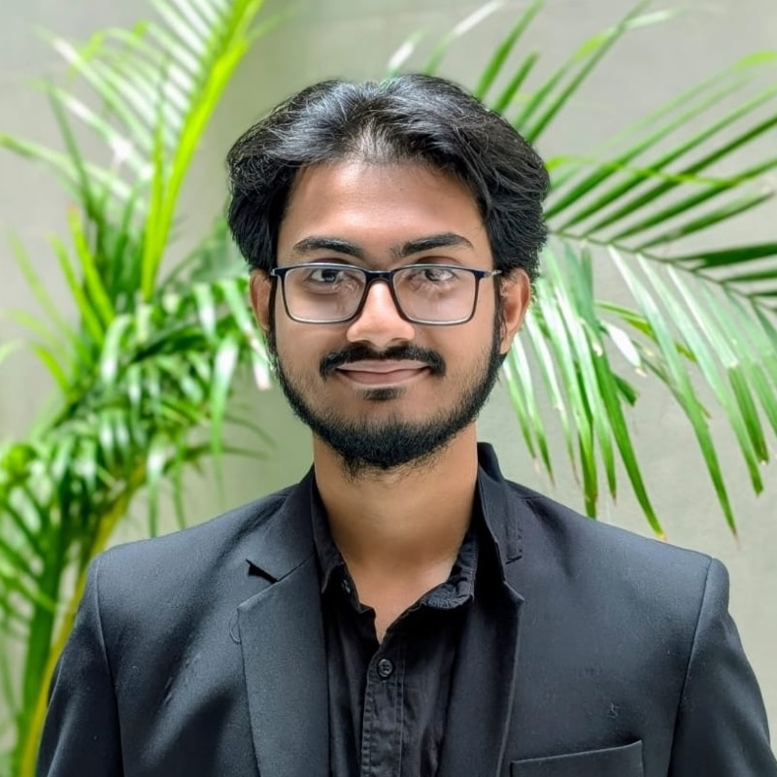


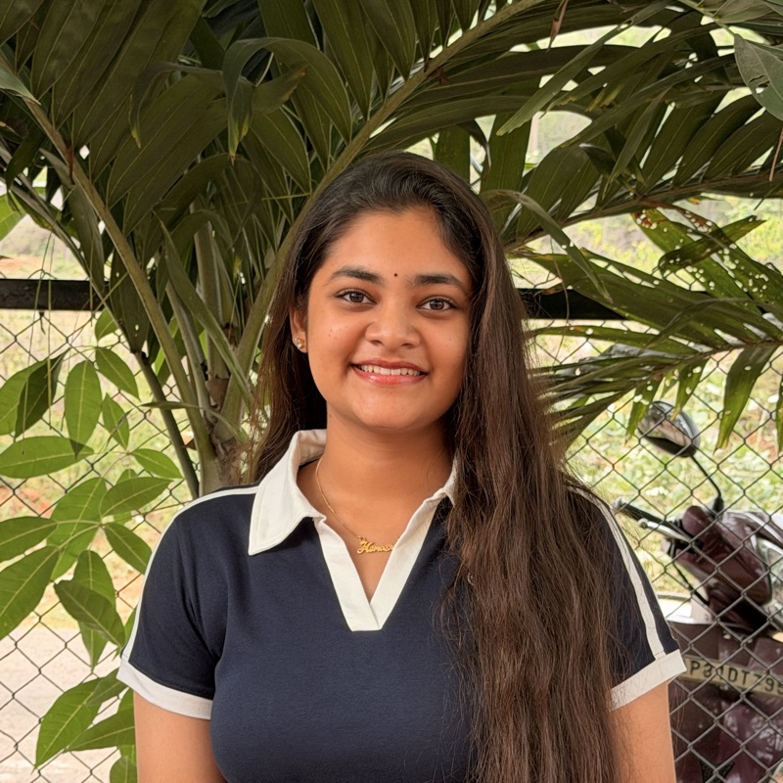
The team
Manas Malla
Kavya Chandana
Gagana Bandaru
Chaitanya Sameer
Kaarthikeyani Peramburi
Satwika Rejeti
Hema Sree Varada
CEO, Co-Founder
SVP, Co-Founder
COO, Co-Founder
CTO, Co-Founder
CFO, Co-Founder
CMO, Co-Founder
CHRO, Co-Founder
Designers, developers and strategists who can take a project from idea to launch, together.

Slide 4


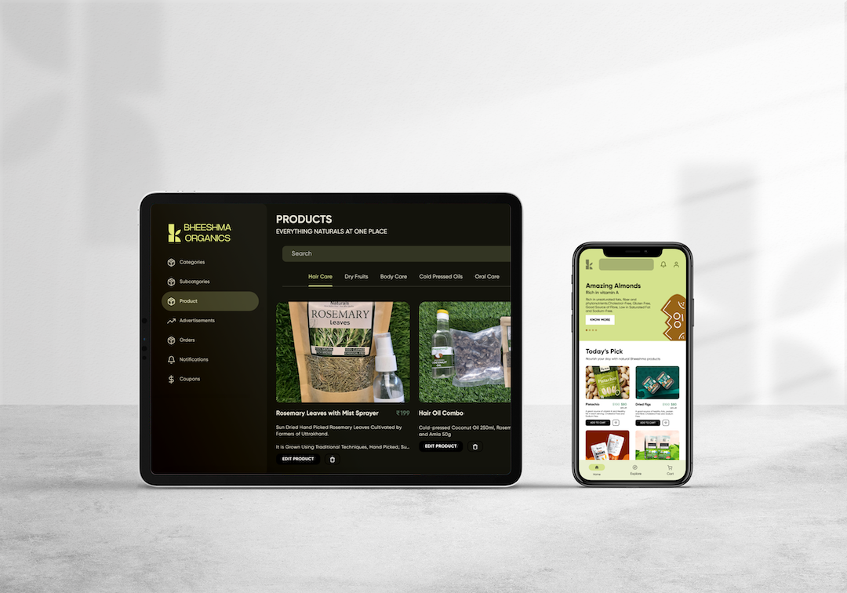

Selected work
Reema Holidays
Shramasa
Bheeshma Naturals
Wash & Go
Development • Product Design • Illustration
Product Design • Branding • Application
Development • Product Design • Animation

Slide 5
Our services
1
2
3
4
Product Design
Development
Marketing
Branding
Idea generation is at the core of our work. We design products that evolve with your brand and your users.
Websites, web apps and native apps built with current technologies, with an eye on scalability and sustainability.
Strategic thinking and market awareness to launch your product and grow it after launch.
Emotion-driven identities, from logo to full brand systems, that leave a lasting mark on your digital presence.

Slide 6
Pricing
Fixed-price projects, scoped up front, so you know the cost before we start.
Launch
Build
Scale
₹50K – ₹75K
₹3L
₹7L
Fixed project price
Fixed project price
Fixed project price
A focused, fixed-scope build to get a product live.
A full custom product with the integrations to run a business on.
High-concurrency systems and automation layers built to scale.
Fixed scope and fixed price
Secure, custom-built application
Cross-platform delivery
Source code and documentation
Fixed scope and fixed price
Secure, custom cross-platform application
Backend and API engineering
Operations automation
Source code and documentation
Fixed scope and fixed price
High-concurrency, scalable architecture
Robust automation layers
Secure, custom cross-platform applications
Source code and documentation

Slide 7
Let's collaborate
hey@theananta.in
theananta.in · dribbble.com/theananta · instagram.com/theananta · x.com/theananta

